Slide 1
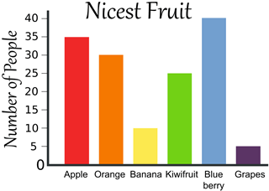
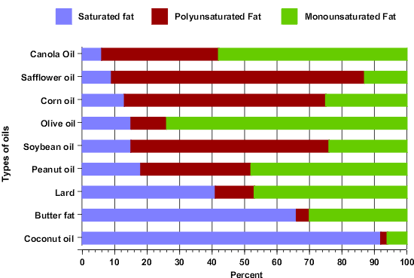
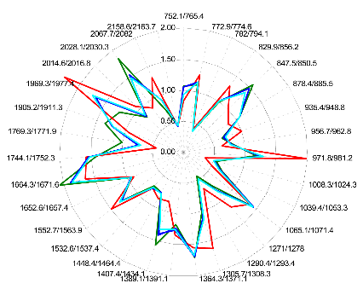
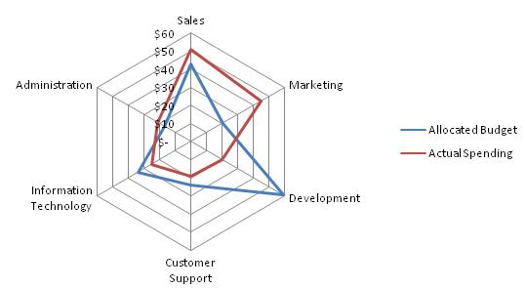
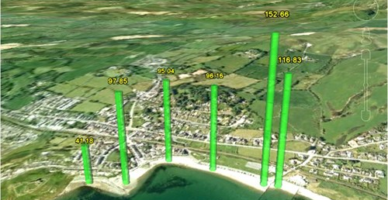
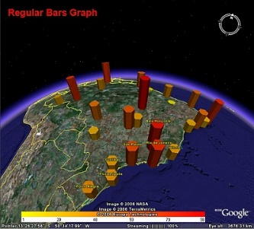
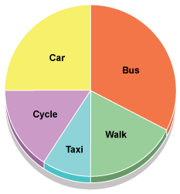
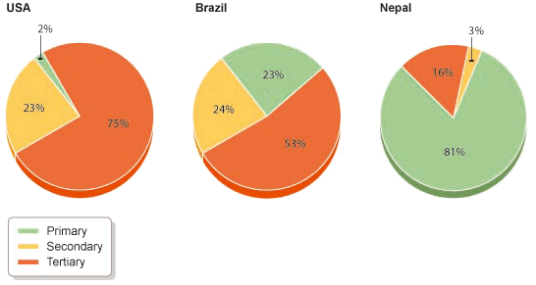
Type of Data Presentation | What it looks like… | Which data it can be used for…
Bar graph |  | Making simple comparisons between several categories of data.
Star graph / Radar graph |  | Comparing the varied characteristics of multiple sites.
GE Graph |  | Same as bar graph but useful for visualizing spatial patterns.
Pie Chart |  | Displaying associated or related characteristics that are all related to the same location.

Slide 2
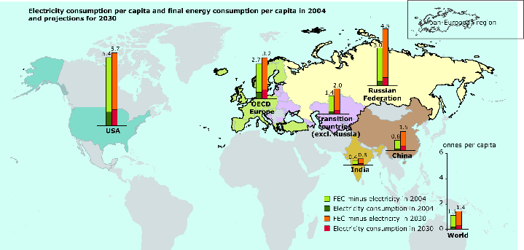
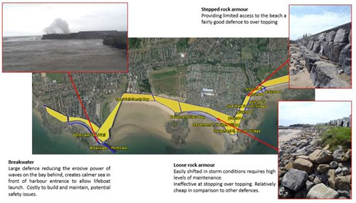
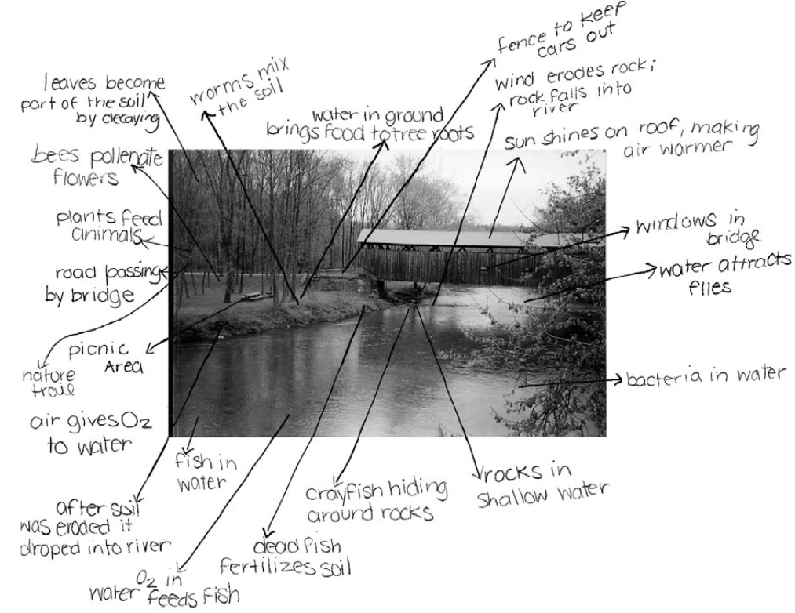
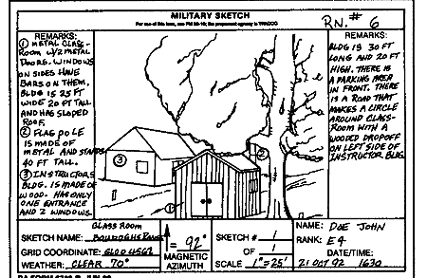
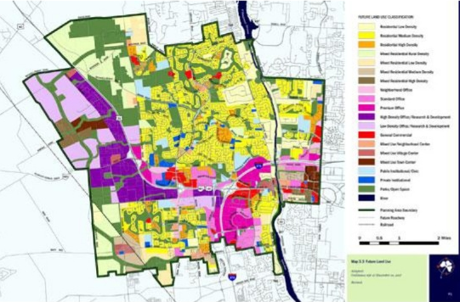
Type of Data Presentation | What it looks like… | Which data it can be used for…
Located graph on map |  | Any of your graphs can be located on a map to show exactly where you collected the data.
Located photo on map |  | Use any of your photos and show where on the map they were taken. This is excellent to support the data you have used in other graphs etc…
Annotated photos or field sketches |  | Pick out the key features of your photos or field sketches. Don’t expect the reader to know what your image refers to, so tell them!
Land Use Map |  | Using colour-coding or symbols to identify land-uses or characteristics.

Slide 3
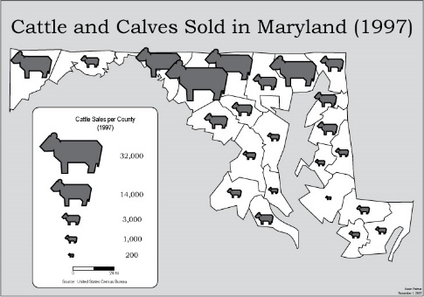
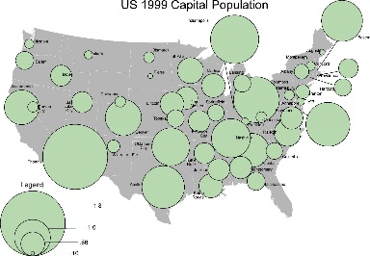
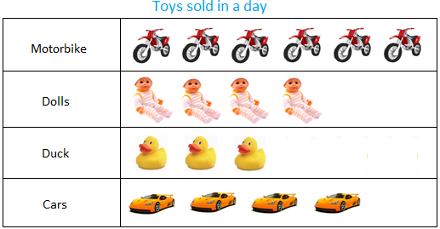
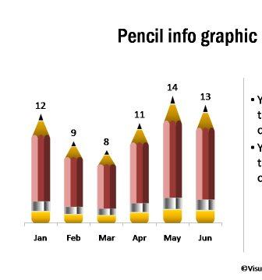
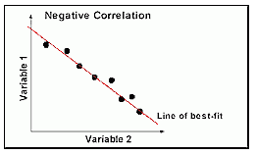
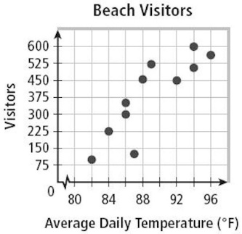
Type of Data Presentation | What it looks like… | Which data it can be used for…
Proportional symbols |  | Any located numerical data to show patterns. The inclusion of a legend is critical.
Pictographs |  | A good way to make simple graphs more visually appealing and relevant to your study.
Scatter Graphs |  | If you want to see a relationship between two sets of data. Include a line of best fit. This can be supported with statistical analysis.
http://www.creativebloq.com/design-tools/data-visualization-712402 See this site for more data presentation techniques.

